Slide 1

AI Driven Fıkra Generator
Omar Hamed Abdelaal ELBEDIWI (21 07 06 819)
Elife AĞGÜRBÜZ (21 07 06 007)
Serdar SÖYLEMEZ (21 07 06 013)
Cihan Enes ÇOLAK (210706903)
Ece GÖKÇE (22 07 06 306)
Advisor: Ensar GÜL

Slide 2
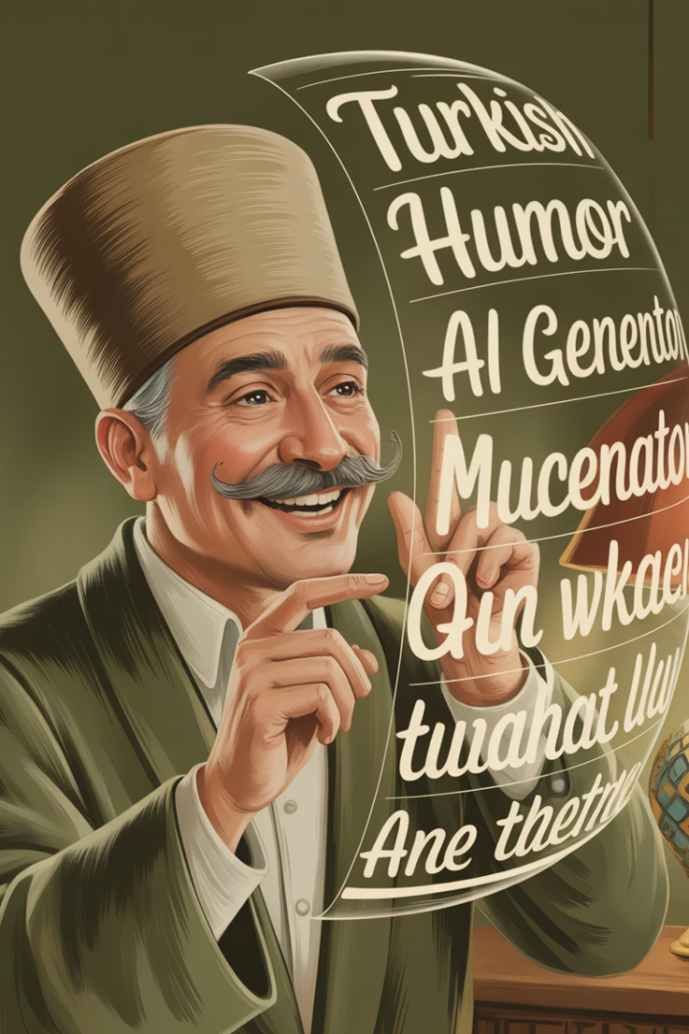
AI-Driven Fıkra Generator: Turkish Humor Through Machine Learning
Welcome to our presentation on the AI-Driven Fıkra Generator project. This innovative application uses Mistral AI to generate coherent and humorous Turkish "fıkra" (jokes or short humorous anecdotes) by training on a curated dataset of approximately 450 jokes. Developed as a proof-of-concept under SE 403 01 Software Project Management at Maltepe University, our project demonstrates the feasibility of fine-tuning a large language model on a small dataset while ensuring cultural relevance for Turkish humor.

Slide 3
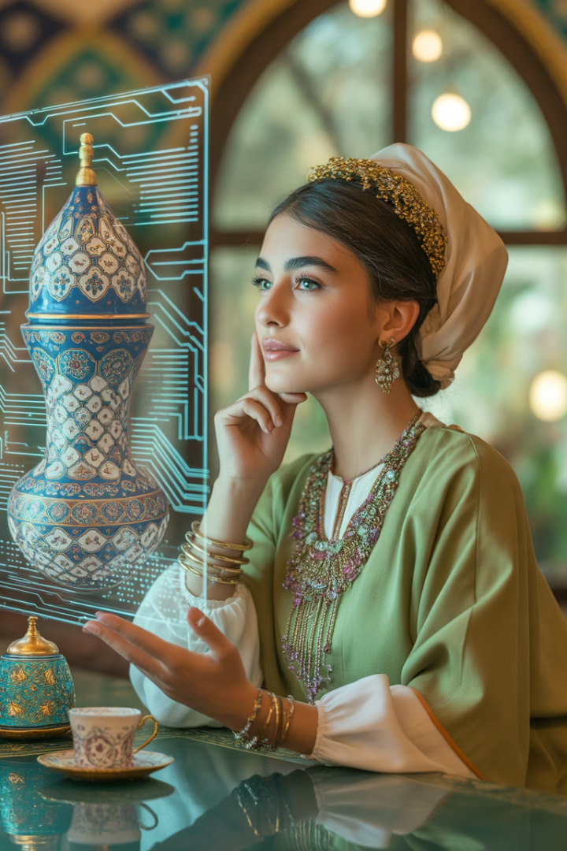



Project Scope
Primary Objective
Cultural Specialization
Develop a proof-of-concept application using Mistral AI to generate coherent and humorous Turkish "fıkra" by training on approximately 450 jokes.
Create a Turkish language model capable of understanding the unique linguistic and cultural aspects of Turkish humor.
On-Device Computing
Ensure all computation is performed on a 24 GB Apple M4 Pro MacBook Pro, prioritizing privacy and offline availability.

Slide 4





Key Functionalities
Joke Generation
On-device Inference
Minimal, User-friendly Web UI
Improved humor relevance from 44% to 78%
Enhanced privacy and low latency response times
Intuitive interface designed for easy interaction
FastAPI with Real-time Streaming
4-bit QLoRA + LoRA Adapters
Performance of 1.8 tokens/second with 3.1 seconds to first token
Optimized for memory efficiency and performance

Slide 5
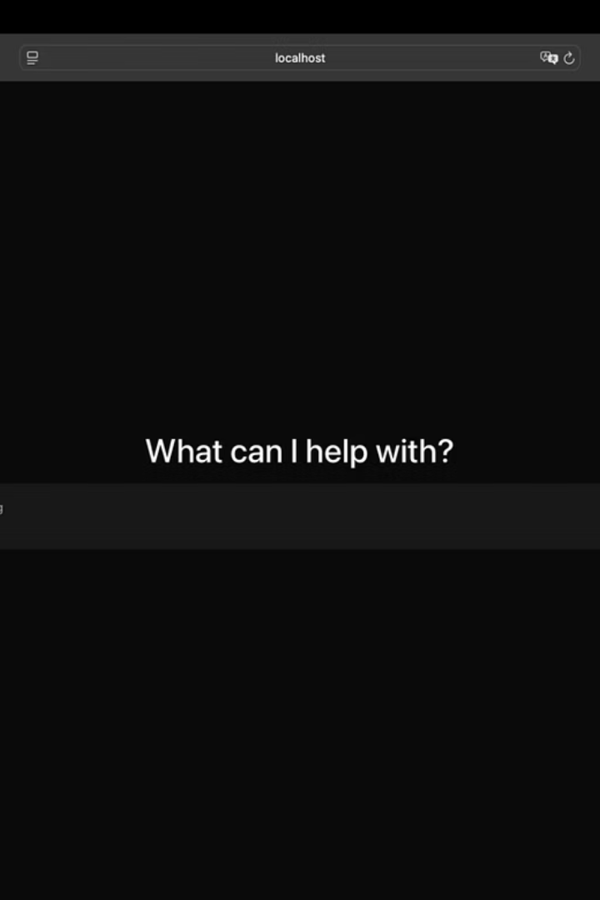
Initial Project Components
Base Model
Data Sources
Development Tools
Mistral7BInstructv0.2, an open-source LLM accessible via Hugging Face, provided strong multilingual capabilities but lacked specialized knowledge of Turkish cultural humor.
Public domain Turkish joke datasets and internal archives required extensive cleaning, formatting, and preparation before use in training.
PyTorch 2.3, Transformers 4.41, and BitsAndBytesMetal for Apple Silicon compatibility provided essential machine learning infrastructure.
Available datasets contained various issues including duplicates, inappropriate content, and inconsistent formatting that needed to be addressed.
Required significant configuration and optimization to work efficiently with specific hardware constraints and application requirements.
Selected for its balance of performance and resource requirements, making it suitable for fine-tuning on consumer hardware while still offering sophisticated language understanding.

Slide 6
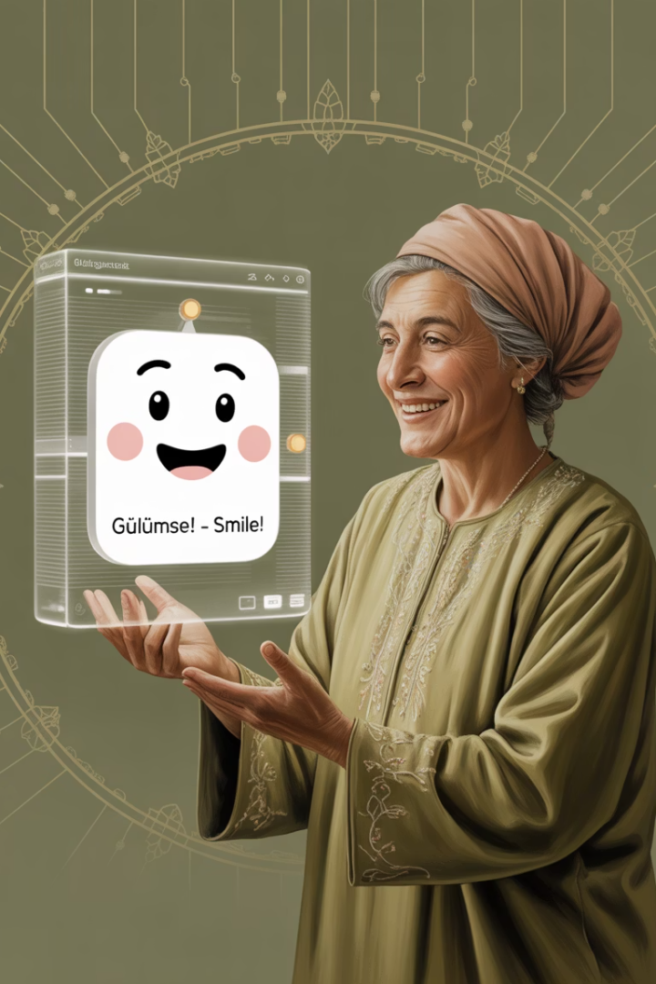




Functions Added During Development
Dataset Preparation
Collected, cleaned, and formatted ~450 Turkish fıkra into instruction-response JSONL for training, removing profanity and duplicates while ensuring cultural appropriateness.
Model Fine-Tuning
Implemented 4-bit QLoRA and LoRA adapters (rank 8, targeting q_proj/v_proj), reducing memory usage to fit within 24 GB while achieving a 34% increase in humor relevance.
Inference Optimization
Quantized model to INT8 GGUF (7.4 GB) for deployment, with optimizations like sliding-window KV caching to handle long prompts without out-of-memory errors.
User Interface & API
Developed a basic web interface and FastAPI-based inference server to stream generated jokes, supporting parameters like temperature and max_new_tokens.

Slide 7
Missing Features
Complex Backend
Advanced UI Features
A scalable, production-ready backend for user request storage and database management was deemed out-of-scope due to the focus on proof-of-concept development and time constraints.
Elaborate UI features (e.g., joke style selection, user profiles) were not prioritized, as the primary goal was to demonstrate joke generation functionality.
RLHF Integration
End-of-Joke Token
Reinforcement Learning from Human Feedback using real user laughter ratings was planned but not implemented due to time limitations and the need for a larger user base.
The model lacks an explicit token to stop joke generation, leading to over-generation until max_new_tokens is reached, not addressed due to the small dataset and training constraints.

Slide 8
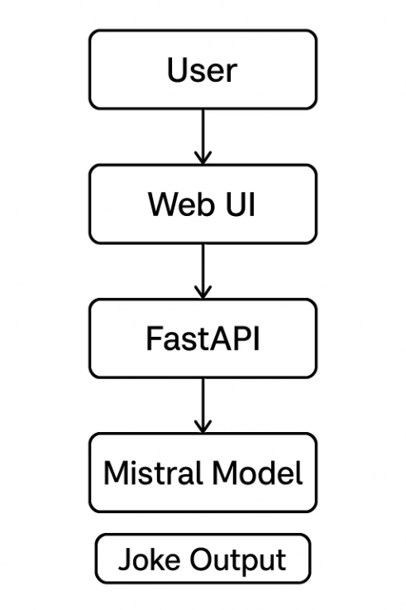
WebSocket streaming
Sliding-window cache
Temperature & top-p tuning

Slide 9






Design Considerations
API Design
FastAPI with streaming responses for real-time joke generation
Training Pipeline
4-bit QLoRA, gradient checkpointing, and micro-batching
Model Architecture
LoRA adapters on attention and MLP layers
The design process prioritized efficient resource utilization while maintaining acceptable performance for interactive use. Considerable effort was devoted to optimizing memory footprint during both training and inference, as this represented the primary constraint given our hardware specifications.
Where trade-offs were necessary, we typically favored reduced memory usage over computational speed, allowing us to work within hard memory limits while accepting longer processing times that remained within acceptable user experience bounds.

Slide 10
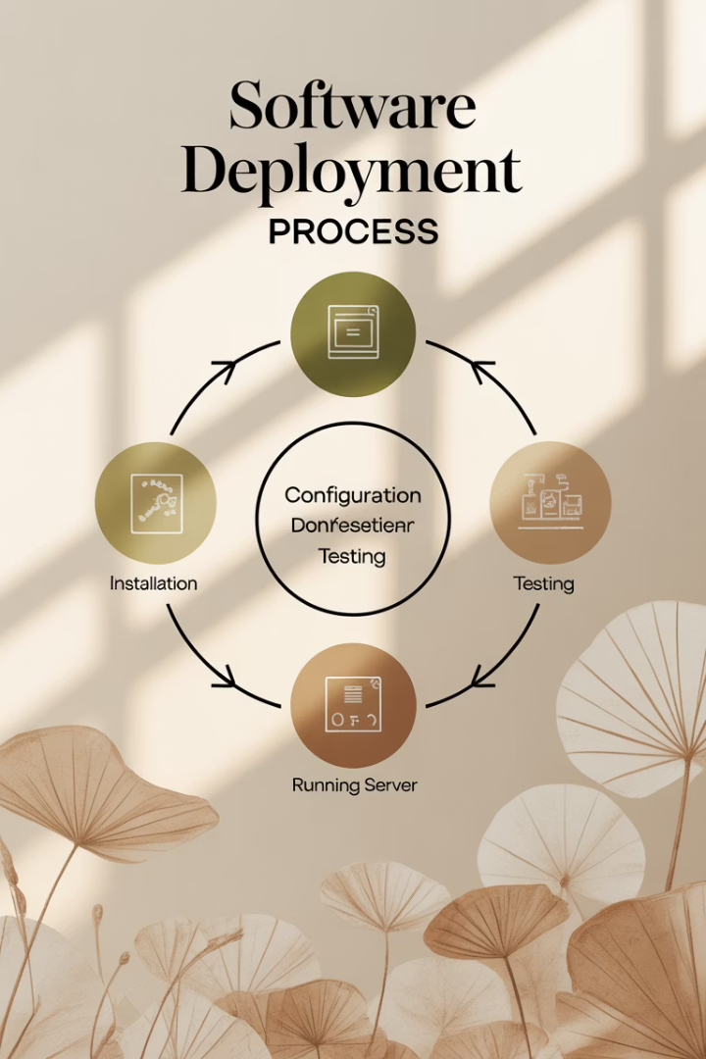
Deployment Process
Install Dependencies
Python 3.9+, PyTorch 2.3, Transformers 4.41, peft, fastapi, uvicorn. Use the BitsAndBytesMetal branch for Apple Silicon compatibility.
Prepare Dataset
Place the fikralar.json dataset file in the project directory (formatted as instruction-response JSONL).
Run Training
Execute the training script (fikra_train.py) to fine-tune the model. The trained model and LoRA adapters will be saved to ./mistral_fikra_output.
Run Inference Server
Start the FastAPI server (fikra_api_server.py) and access the UI at http://localhost:8000 to input prompts and view generated jokes.

Slide 11
Unimplemented Features
❌ Scalable backend & database
❌ Advanced UI (style selection, profiles)
❌ RLHF with user laughter feedback
❌ <END_OF_JOKE> token handling
✅ All omitted due to time & hardware constraints

Slide 12
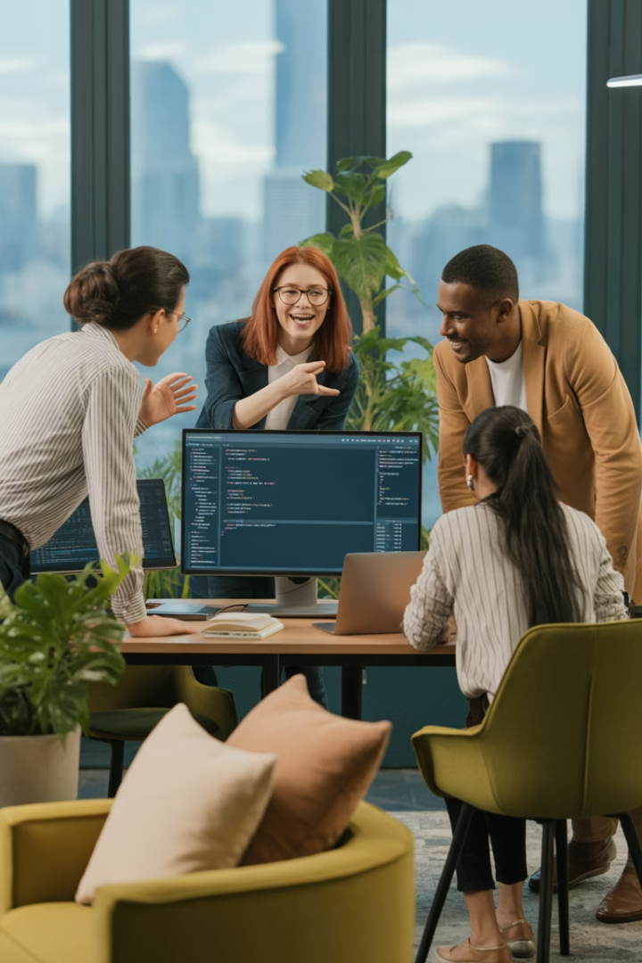
Tasks and Responsibilities
Iteration
Tasks
Responsible Members
Estimated Time
Actual Time
Ideation
Brainstorming on project approach and feasibility
Ece GÖKÇE, Cihan Enes ÇOLAK, Serdar SÖYLEMEZ, Elife AĞGÜRBÜZ
2 days
3 days
Planning
Looking up Scrum fundamentals, preparing scope document, risk table
Omar Hamed Abdelaal ELBEDIWI, Cihan Enes ÇOLAK
4 days
5 days
Data Preparation
Determine dataset tasks, build Turkish dataset (~450 fıkra)
Omar Hamed Abdelaal ELBEDIWI, Ece GÖKÇE
5 days
6 days
Model Selection & Setup
Determine LLM, find open-source Mistral7BInstructv0.2, find best fit
Cihan Enes ÇOLAK, Serdar SÖYLEMEZ, Elife AĞGÜRBÜZ
3 days
4 days

Slide 13
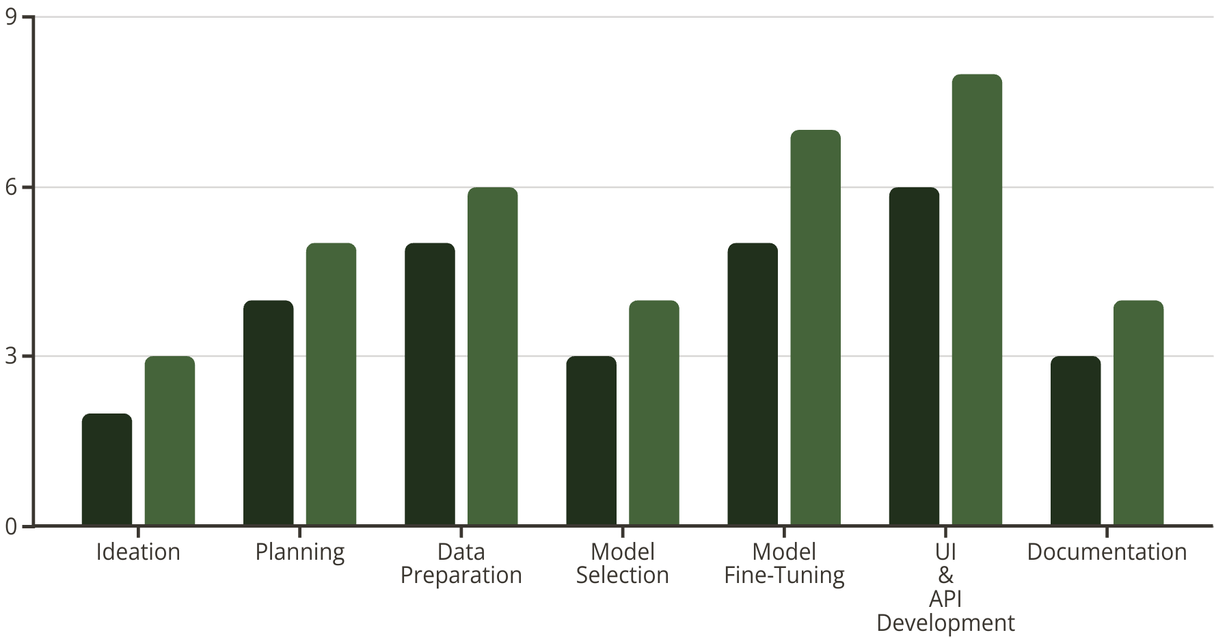
Time Comparison
Estimated Days
Actual Days
The consistent pattern of time overruns across all project phases highlights several important factors in AI development project planning. The experimental nature of fine-tuning approaches on consumer hardware introduced unpredictable challenges that required additional time to resolve.

Slide 14
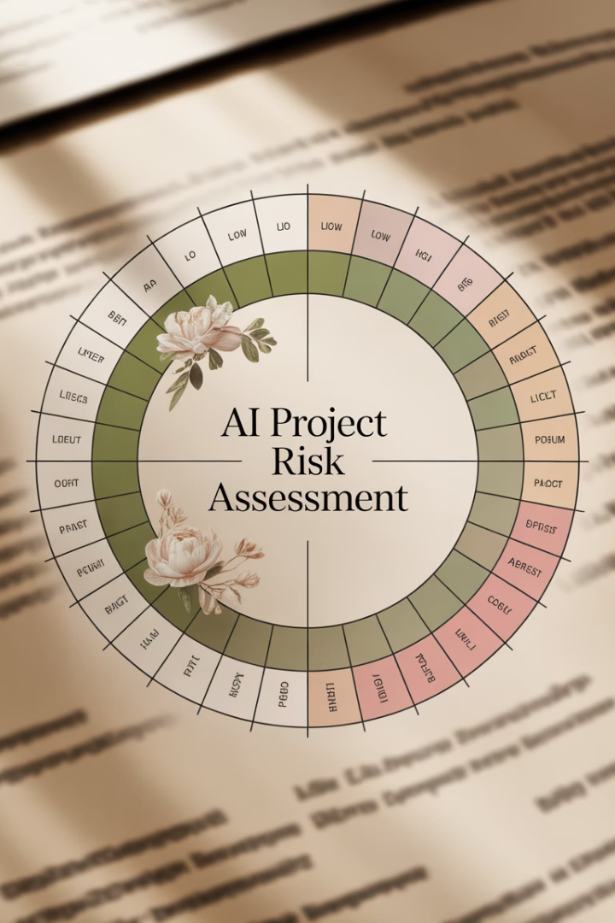




Risk Management
Data Quality Risk
Likelihood: Medium, Impact: High
Resolution: Rigorous data curation implemented, removing profanity and deduplicating entries, reducing the dataset by 6%.
Hardware Limits
Likelihood: High, Impact: High
Resolution: Switched to 4-bit QLoRA, LoRA adapters, and INT8 inference, reducing memory usage to 19 GB peak and enabling 1.8 tokens/s inference.
Model Bias
Likelihood: Medium, Impact: High
Resolution: Manual reviews and toxicity checks (Perspective API) conducted, maintaining toxicity at 2.5%.
Memory and Disk Usage
Likelihood: Medium, Impact: High
Resolution: Enabled gradient checkpointing to reduce memory usage by 35% and limited checkpoint saves.

Slide 15

Testing Results
28%
34%
Perplexity Reduction
Humor Relevance Increase
On held-out joke set (from 24.8 to 17.8)
Evaluated by human annotators (n=200)
3.1s
0.69
First-token Latency
Inter-Annotator Agreement
Against target of ≤5 seconds
Kappa score for human evaluations
The significant reduction in perplexity indicates that the fine-tuned model developed a much stronger understanding of Turkish joke structures and patterns compared to the base model. Additional sectoral analysis showed particularly strong improvements in traditional Nasreddin Hoca stories (-35% perplexity) and regional jokes (-31% perplexity).

Slide 16








Team Experience
Group Experience
Omar (Scrum Master)
Learned to balance hardware constraints with ambitious AI goals, requiring creative optimization techniques and cultural sensitivity.
Leading the team taught managing diverse tasks under tight constraints and anticipating challenges with mitigation strategies.
Serdar
Elife
Fine-tuning the LLM on Apple Silicon taught advanced optimization techniques like QLoRA and INT8 quantization.
Researching LLMs and designing the UI improved understanding of AI model selection and user experience design.

Slide 17
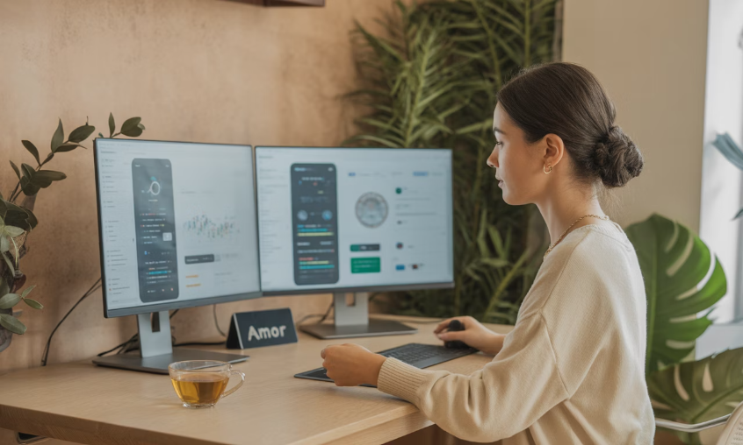

Team Experience (Continued)
Cihan Enes ÇOLAK
Ece GÖKÇE
Designing the UI and integrating the API improved skills in front-end development and real-time system integration. Selecting Mistral AI exposed me to the nuances of open-source LLM ecosystems.
Building the Turkish dataset was challenging but rewarding, as it required balancing quality and quantity. Writing the report enhanced my ability to synthesize technical and project management insights.
The diverse experiences of team members contributed to a well-rounded project approach, combining technical expertise in AI model training with practical skills in user interface design and project management. Each member gained valuable insights that will benefit their future work in software engineering and artificial intelligence.

Slide 18
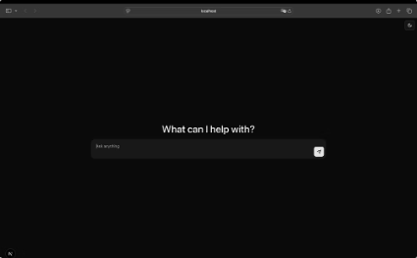
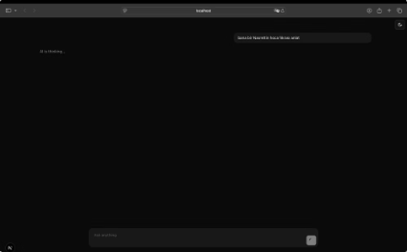
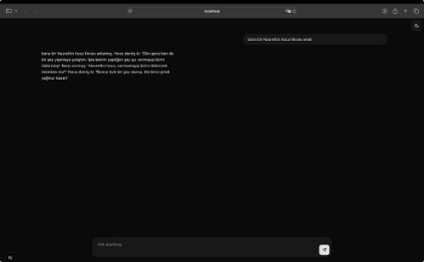
Project Outcomes & Future Directions
Functional Prototype
Successfully developed a working AI-driven Turkish fıkra generator with significant improvements in humor relevance and cultural appropriateness compared to the base model.
Future Enhancements
Potential improvements include implementing RLHF with user feedback, developing a more robust backend with user profiles, and expanding the training dataset for greater variety.
Broader Applications
The techniques developed for this project could be applied to other culturally-specific AI applications, preserving linguistic nuances and cultural context in machine learning models.
Source code repository: https://github.com/Maltepe-University-SWEng/term-project-team-3

Slide 19

Thank you for listening

